Slide 1
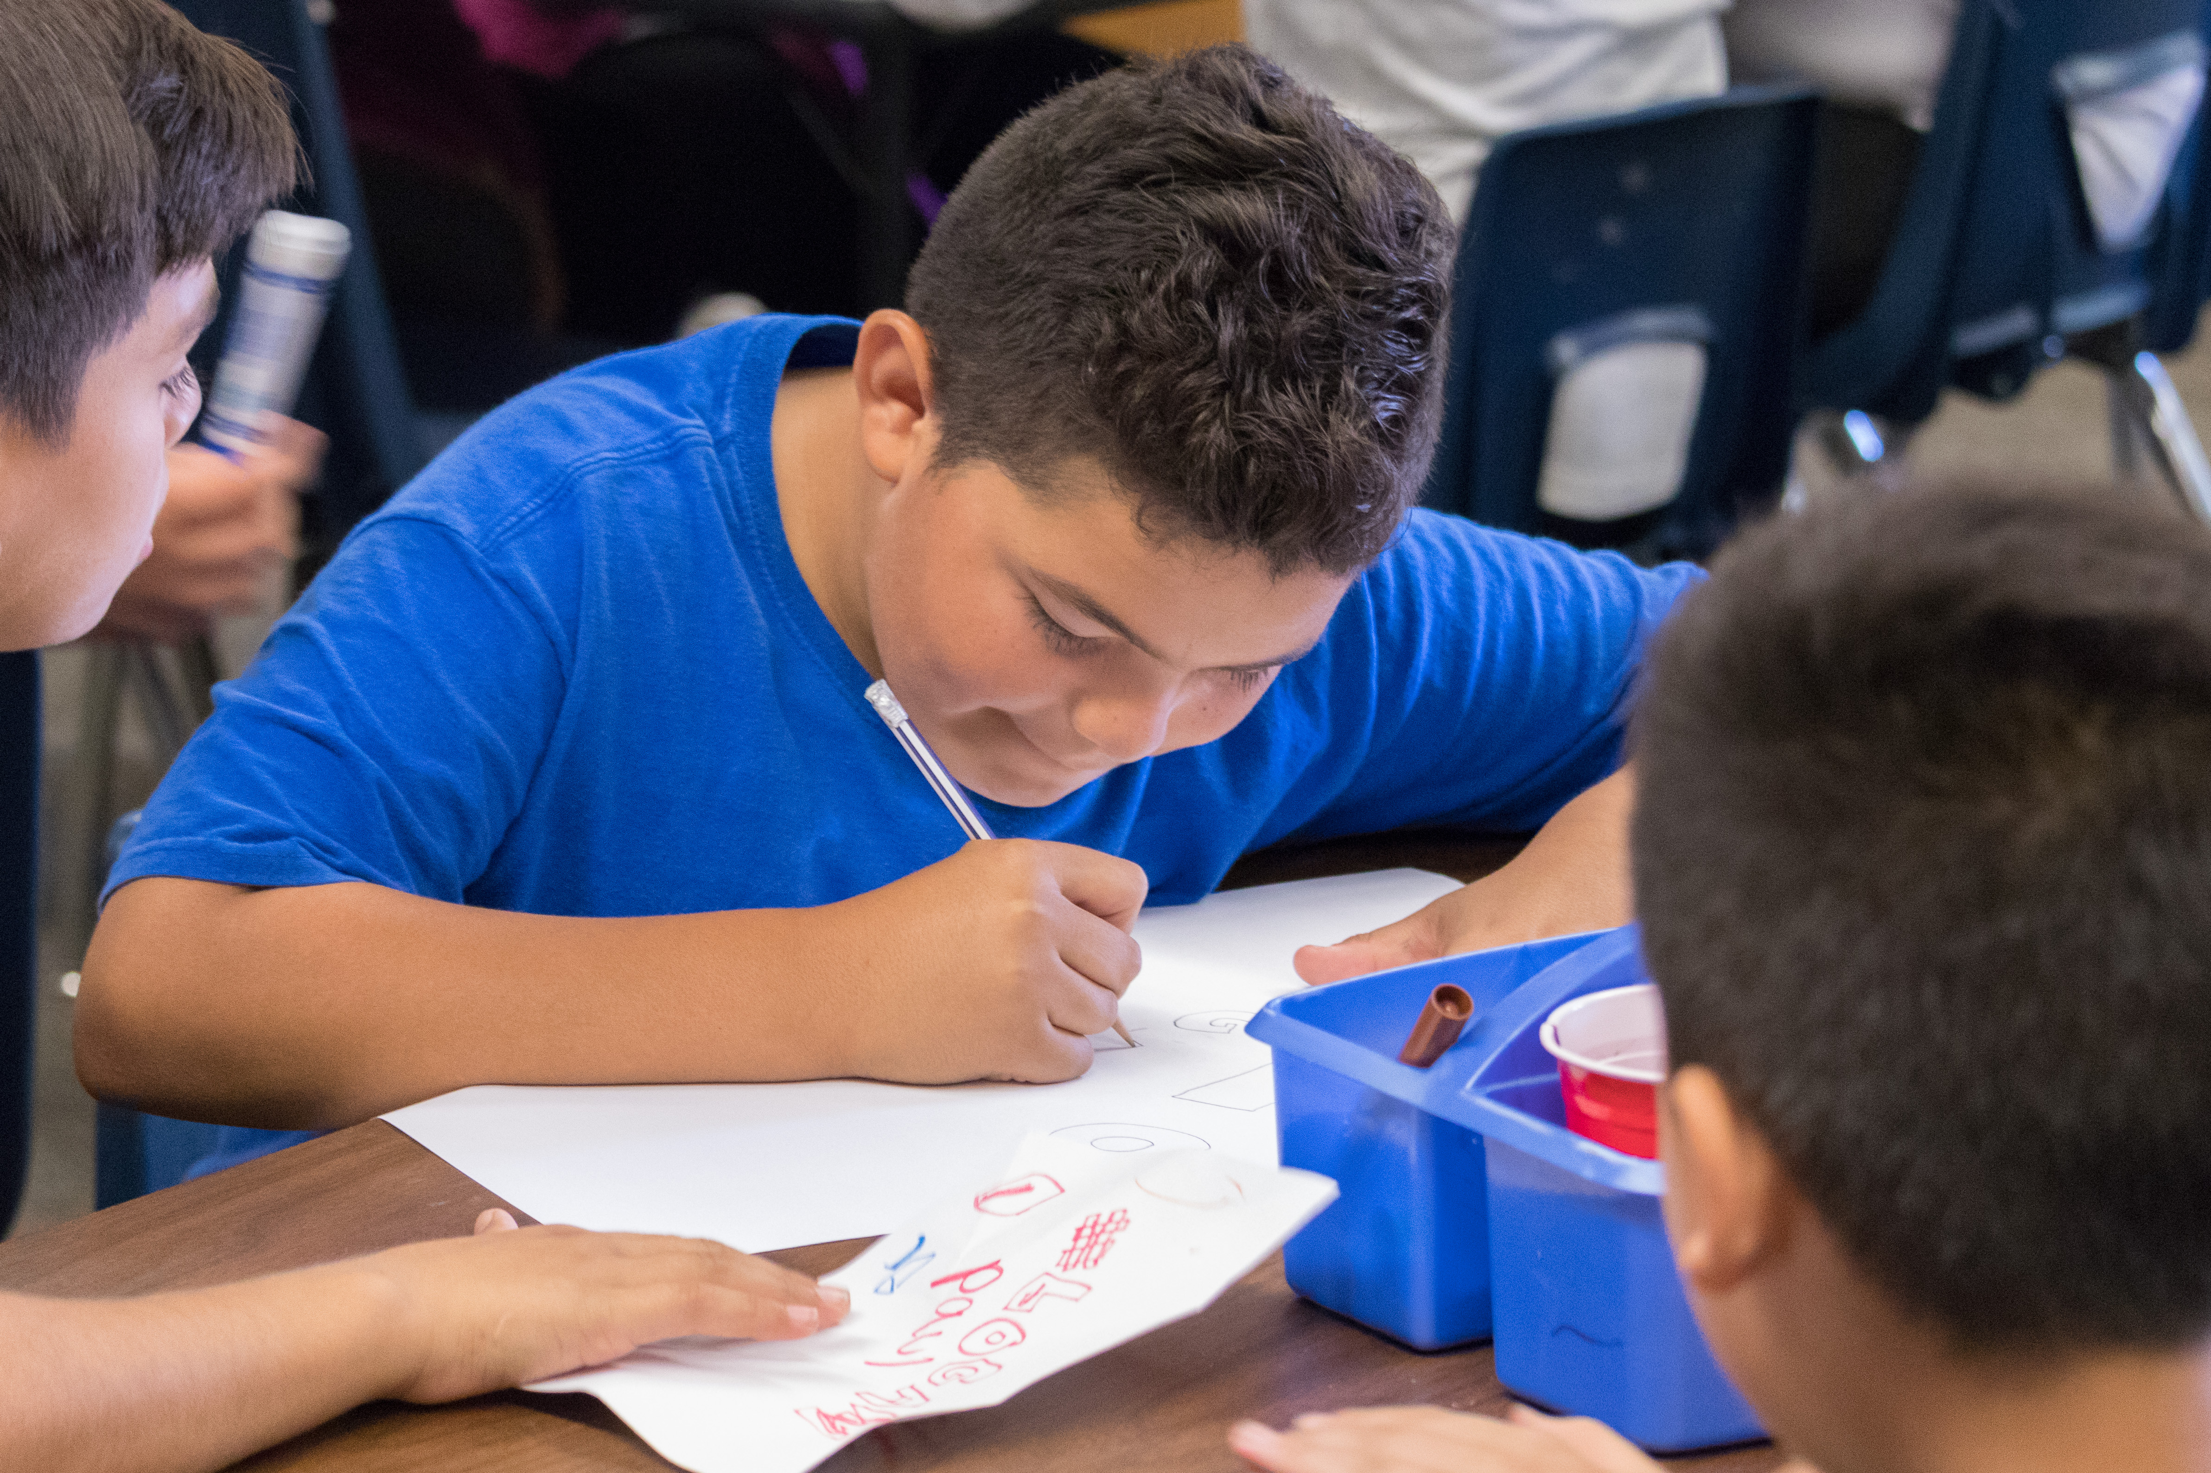
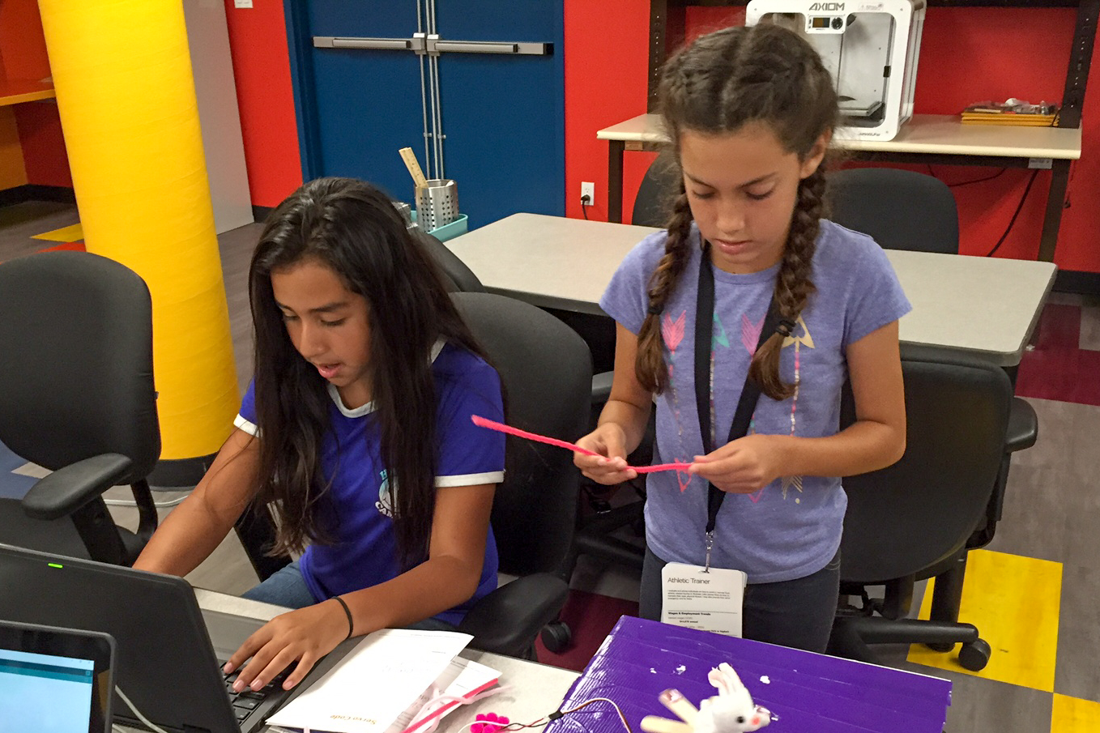
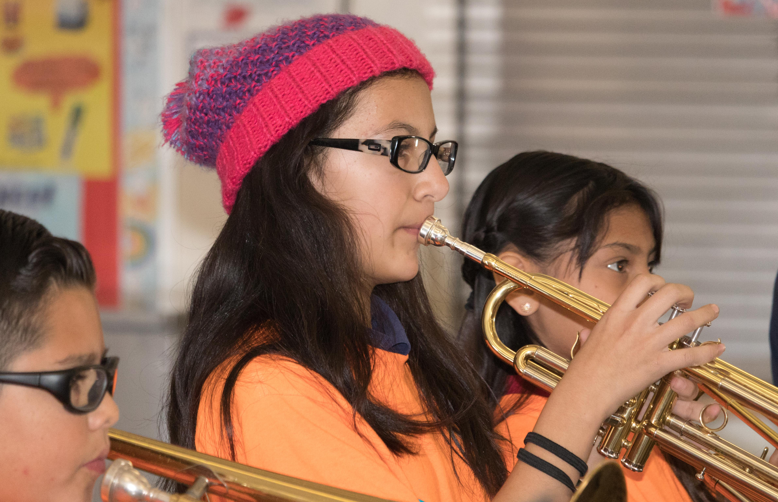
Informing & Engaging Our Learning Community
Notes:
Today I will be sharing with you an overview of our Districts Local Control and Accountability Plan.
In June 2017, the board approved our current 3 year Local Control Accountability Plan. Our current plan runs from 2017 through 2020.
This year, we must review our current LCAP plan, monitor its effectiveness, solicit input from stakeholder groups on how to improve our plans and then submit an updated plan to our Board of Education for approval.

Slide 2
Executive Order N-26-20
2020-2021 Local Control and Accountability Plan deadline
to December 15, 2020
July 1, 2020 update in regard to COVID-19 plans and support

Slide 3
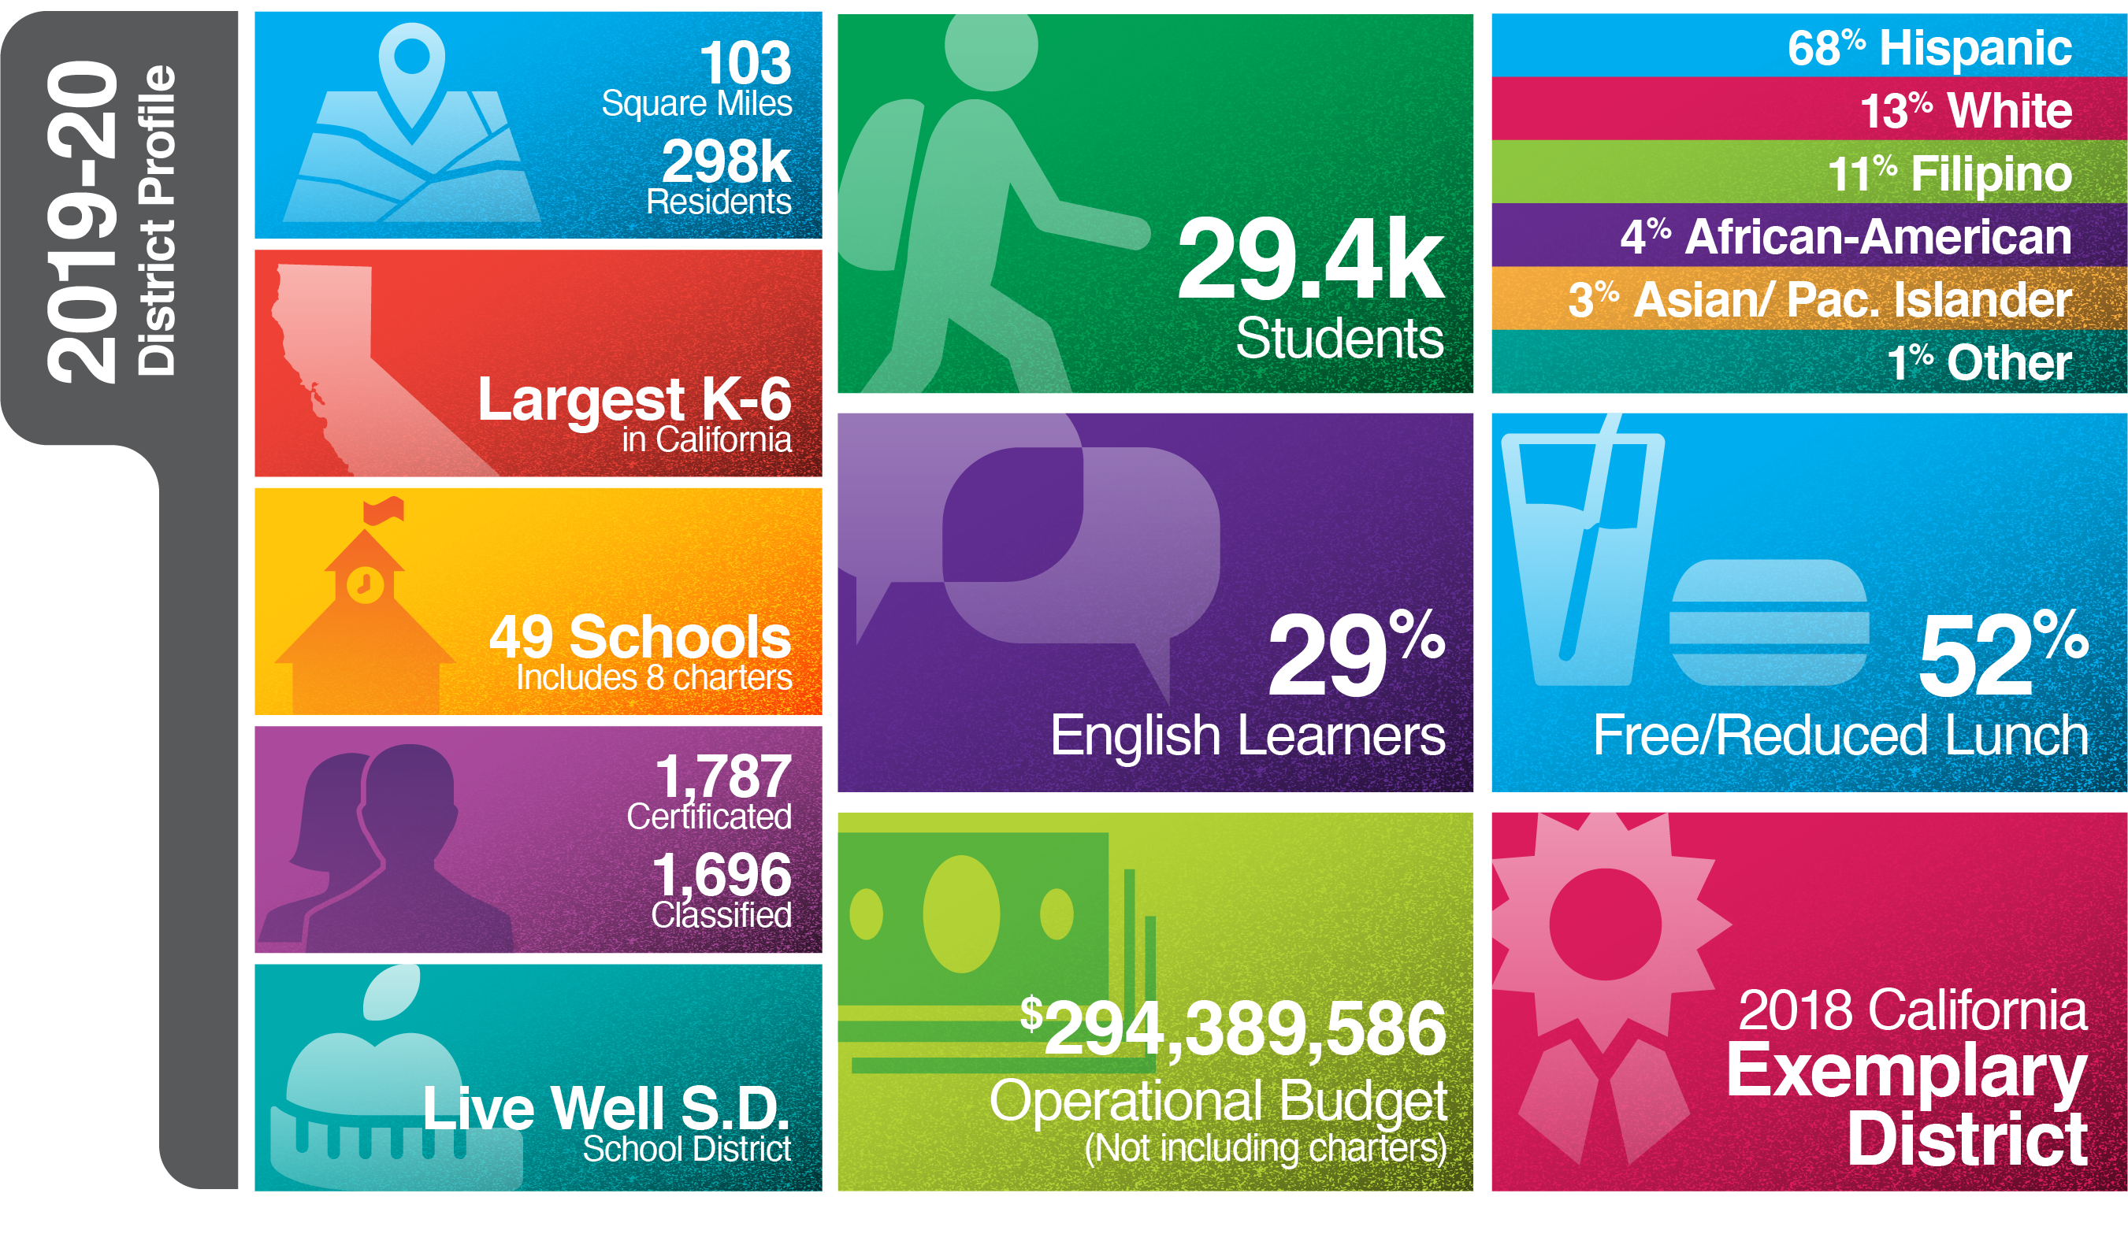
Our District
Notes:
On this slide you will see key demographics related to our school district. We are a large school district with nearly 30,000 students. We celebrate the diversity of our students. If a student knows a second language, a language other than English, we view that as a strength, an asset. That mindset helps contribute to our academic success as can be seen by the recognition received.

Slide 4
CVESD Instructional Focus Statement
The CVESD community will work collaboratively to ensure that ALL students, including English Learners, Students with Disabilities, and designated target groups, show measurable growth, which will lead to reducing the achievement gap in literacy and mathematics.
This will occur through the implementation of high impact language development strategies aligned to the California State Standards, and driven by the District’s LCAP goals.
Target Groups = English Learners, Students with Disabilities, Socio-Economically Disadvantaged, and Foster Youth
Notes:
Our District has an instructional focus statement that helps ensure all students, especially our target students, demonstrate continuous growth in literacy and mathematics. This school year our teachers and administrators have been learning and implementing strategies that will help students in these areas.

Slide 5
Our Shared Vision
Families, staff, and our entire community are full partners actively working in a collaborative manner for the benefit of each child's education. Together we have an investment in our District's Vision and believe a child's success equals our success. We ensure an environment in which everyone is valued and treated with dignity and respect. Everyone assumes responsibility for the success of the school community.
Notes:
Let’s take a look at the District’s Shared Vision.
Our vision represents what we stand for and what we strive for. All of our key decisions must be coordinated and tied to our vision.

Slide 6
LCAP - Local Control and Accountability Plan
Unduplicated Students
EL - English Learner
Students learning English as a second language
FY - Foster Youth
Students living in foster care
LI – Low Income
Students living at or below the poverty level

Slide 7
Thoughtexchange
Top Themes (includes Town Hall Meeting)
Engagement process conducted from February 18, 2020 through March 20, 2020. 2,119 participants provided input towards the District LCAP, sharing 4,269 thoughts.
1 - Maintain and/or expand VAPA
2 - Additional SEL and behavior supports
3 - Community connections and learning (Stations)
4 - Increase parent engagement
5 - Deep appreciation for quality staff (admin., teachers, classified)

Slide 8
Chula Vista Classified Employees Organization (CVCEO)
Top Themes
CVCEO, who represents our classified employees, has been a partner with the LCAP process throughout the year. Below are dates that CVCEO collaborated with District staff to provide input and updates to the LCAP.
1 - Maintain student attendants
2 - Maintain attendance health supports
3 - Maintain library hours
4 - Maintain, at minimum, technology equipment technician (TET) support
5 - Increase TET support
Apr 7, 2020
Dec 10, 2019

Slide 9
CVESD Community Stakeholders’ Town Hall
A focused 'Town Hall' meeting took place at Hedenkamp Elementary to gather input from all stakeholders in the CVESD community. Below is the date that this Town Hall occurred.
Mar 11, 2020

Slide 10
CVE Town Hall Meetings
Two focused 'Town Hall' meetings were held for teachers at one of our school sites, Hedenkamp, to gather educator focused input, in addition to the Thoughtexchange process this year. Below are the dates that these Town Hall meetings took place.
Feb 20, 2020
Feb 25, 2020

Slide 11
Chula Vista Educators (CVE)
Top Themes (includes 2 Town Hall meetings)
CVE, who represents our certificated employees, has been a partner with the LCAP process throughout the year. Below are dates that CVE collaborated with District staff to provide input and updates to the LCAP.
1 - Maintain and/or expand VAPA
2 - Additional SEL and behavior supports
3 - Maintain class size reduction in all grades
4 - Additional money for yearly raises to attract and retain teachers
Aug 20, 2019
Oct 15, 2019
Nov 5, 2019
Dec 3, 2019
Jan 28, 2020
5 - Increase technology in schools

Slide 13
CVESD Administrators
Top Themes
CVESD administrators are represented by our directors, coordinators, principals, associate principals, and lead psychologists, who have been an integral part of the LCAP process.
1 - DI teacher incentives
2 - Additional SEL and behavior supports
3 - Additional site funds
4 - Maintain parent liaison
Dec 10, 2019
Feb 5, 2020
5 - Increase technology in schools position

Slide 14
District Advisory Committee (DAC)/District English Learner Advisory Committee (DELAC)
Top Themes
1 - Maintain and/or expand VAPA
2 - Additional SEL and behavior supports
3 - Additional site funds
4 - Increase parent engagement
5 - Increase technology in schools
DAC/DELAC is comprised of parents and community leaders who represent Chula Vista Elementary School District.
Feb 11, 2020
Apr 28, 2020

Slide 15
Parent Focus Groups
Top Themes
(11 Schools)
11 of CVESD's highest needs schools, with the highest percentage of unduplicated students, participated in face to face input gathering sessions. Focus groups of parents from these schools provided invaluable information about their child's and/or children's educational experience and what they want to see continue and done differently with the new iteration of the LCAP.
1 - Maintain and/or expand VAPA – provide them after school as well
2 - Additional SEL and behavior supports
3 - More hands-on experiences and field trips (Stations)
4 - After school programs for students (SIPPS, Dinosaur School)
5 - Keep our highly qualified teachers
Lauderbach Oct 11, 2019
Montgomery Oct 18, 2019
Vista Square Oct 25, 2019
Harborside Nov 15, 2019
Castle Park Nov 22, 2019
Loma Verde Mar 13, 2020
Otay Dec 13, 2019
Los Altos Jan17, 2020
Rice Jan 24, 2020
Rohr Jan 31, 2020
Kellogg Feb 21, 2020

Slide 16
Student Focus Groups
Top Themes
(11 Schools)
11 of CVESD's highest needs schools, with the highest percentage of unduplicated students, participated in face to face input gathering sessions. Focus groups of students from these schools provided invaluable information about their educational experience and what they want to see continue and done differently with the new iteration of the LCAP.
1 – Maintain and/or expand VAPA
2 – Support for classmates with behavior issues
3 - More hands-on STEM and field trips (Stations)
4 - Healthier menu
5 - More PE options, equipment, and time
Lauderbach Oct 11, 2019
Montgomery Oct 18, 2019
Vista Square Oct 25, 2019
Harborside Nov 15, 2019
Castle Park Nov 22, 2019
Loma Verde Mar 13, 2020
Otay Dec 13, 2019
Los Altos Jan17, 2020
Rice Jan 24, 2020
Rohr Jan 31, 2020
Kellogg Feb 21, 2020

Slide 18
Questions? Comments?
Notes:
Mention to Principals that you will be receiving this PPT to share with staff and parent groups.

