Slide 1
Smarty Ants accelerates students' mastery of foundational reading skills through personalized game-based instruction

Slide 2

Step-by-Step Foundational Literacy Skill Building
Sight Words
Transition to comprehension via:
authentic literature
science texts (life, earth, and physical sciences)
Vocabulary Development
Personalized Practice
Fluency
Game-Based Engagement
Phonics
Mastery of Foundational Skills
Phonemic Awareness
Learning to read so they can read to LEARN
Alphabetic Principles

Slide 3
Smarty Ants Scope & Sequence
Grade | Levels | Lessons | Lesson Content
PreK | 1-2 | 19 lessons #1ABC-2 | Upper & Lower-case letter names Simple Word Building
Kinder | 3-6 | 36 lessons #3-39 | Letter Sounds CVC Words Silent e Blends Consonant Digraphs
First | 7-11 | 29 lessons #40-69 | R-Controlled Vowels Letter Combinations Alternate Vowel Diagraphs Compound Words Suffixes Prefixes Syllables Contractions Pronouns Possessives
Second | 12-18 | 27 lessons #70-97 | Reading Comprehension and Oral Fluency Authentic Literature from Candlewick Press Nonfiction Science Texts Life Science Earth Science Physical Science
Personalized Practice
Game-Based Engagement
Mastery of Foundational Skills

Slide 4
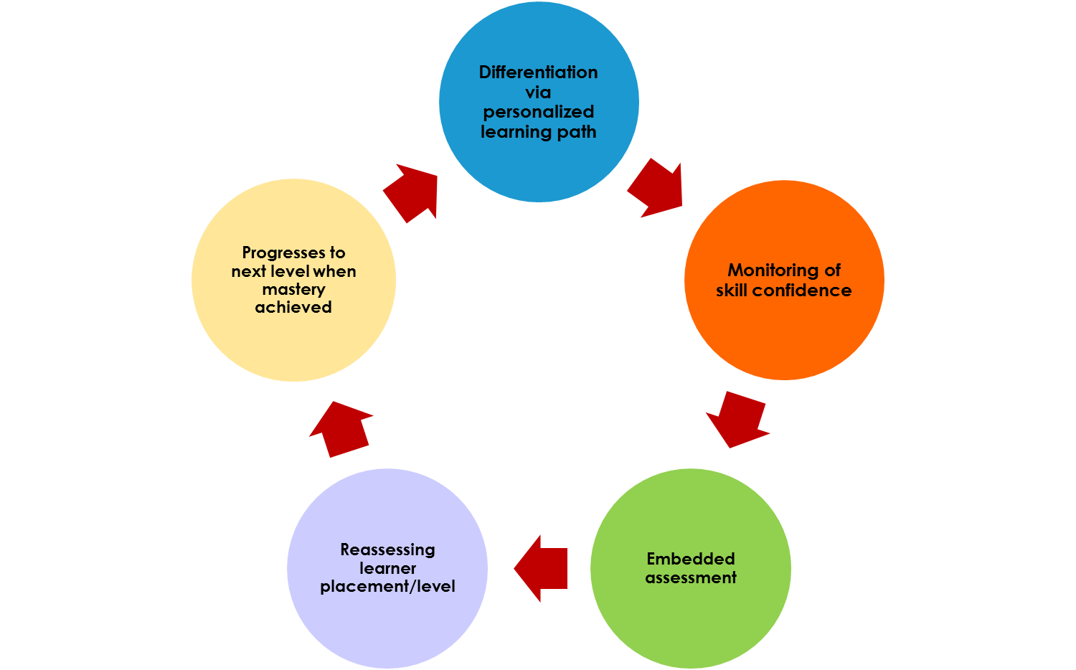
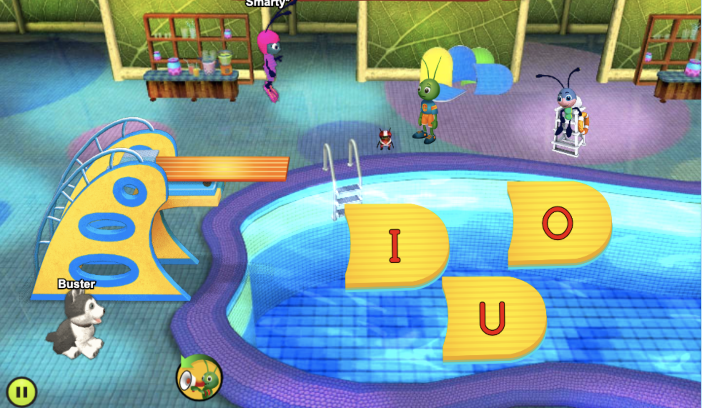
Placement Assessment to Personalized Learning Path
PERSONALIZED PRACTICE
Game-Based Engagement
Mastery of Foundational Skills
Notes:
Students begin with a placement assessment at their grade level
Adaptive
Upon completion student placed in their personalized learning path to mastery

Slide 5
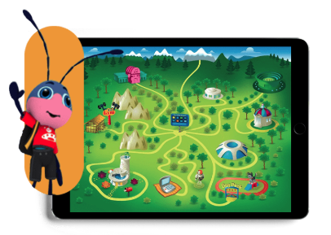
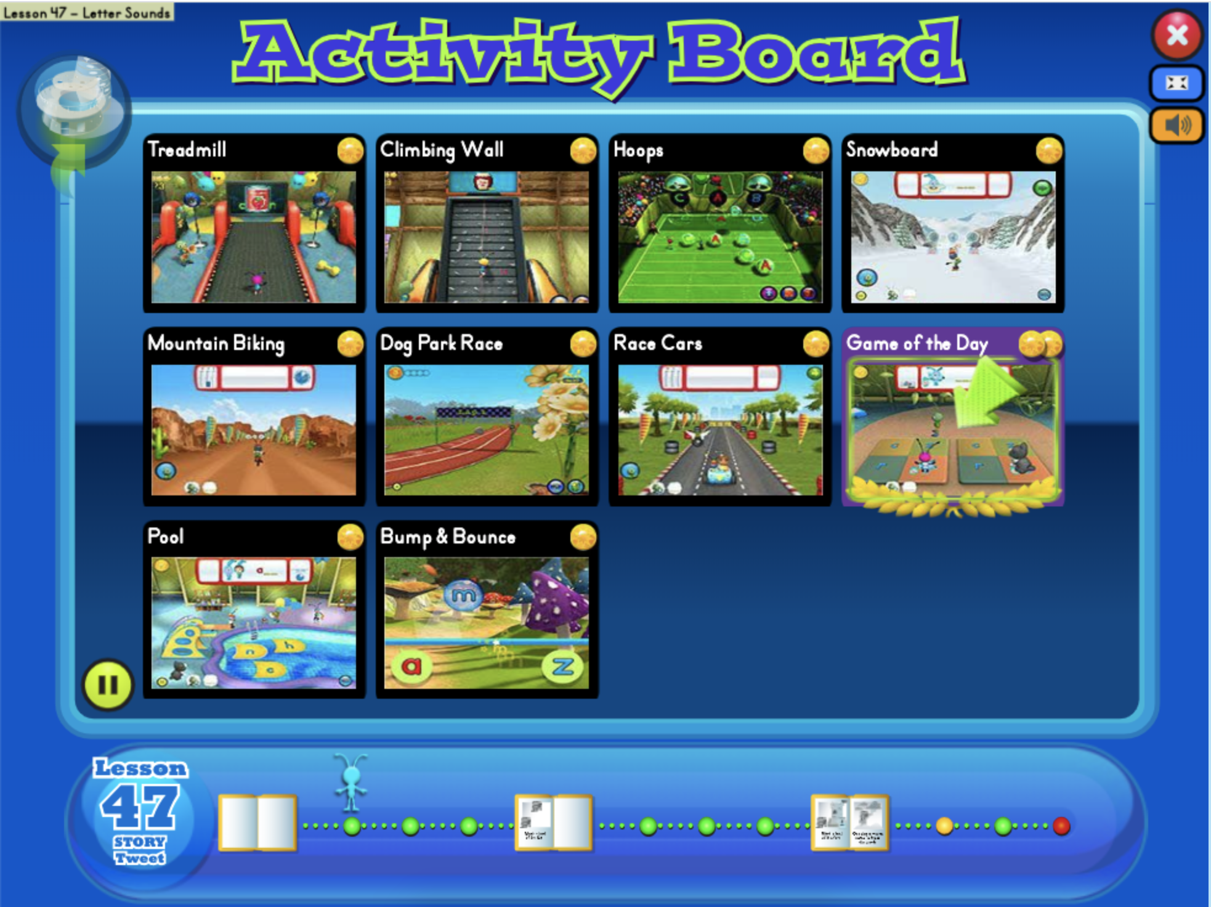
Personalized Practice for Every Student
PERSONALIZED PRACTICE
Game-Based Engagement
Mastery of Foundational Skills
Notes:
Students, with the help of their personal ant, travel through and completed the Smarty Ants’ scope and sequence. From letter identification and the alphabetic principle to structural analysis and comprehension skills, Smarty Ants transforms emergent readers into independent readers.
In Smarty Ants’, there are over ninety unique learning pathways that emergent readers can take. No two students will approach the content or process in the same manner, but they will all reach the same critical milestones for primary-grade literacy success, emerging as confident, capable readers

Slide 6
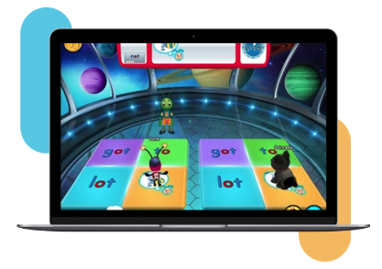
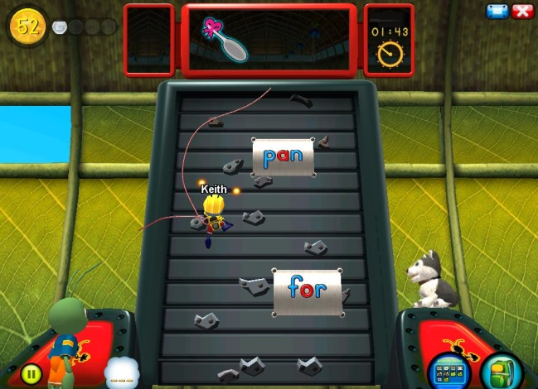
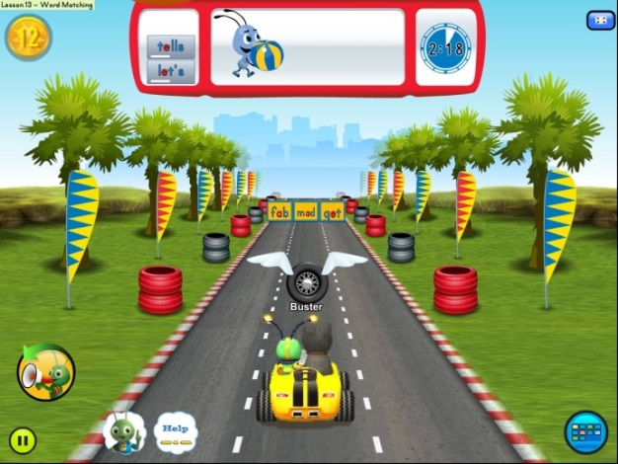
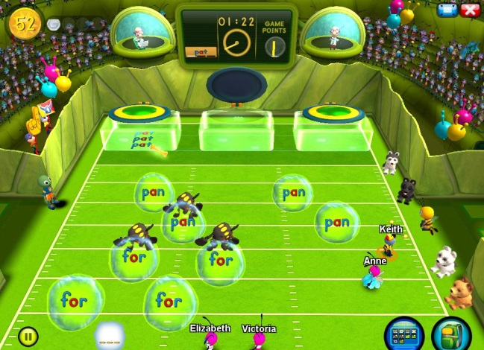
A Fun Environment for Mastery and Success
Personalized Practice
GAME-BASED ENGAGEMENT
Mastery of Foundational Skills
Notes:
Built-in motivation with a supportive ant coach, dog companion, coins for student accomplishments, and a unique, customizable ant avatar for every child
Engaging offline learning experiences, including multisensory activities, to support students with a range of learning needs
.

Slide 7
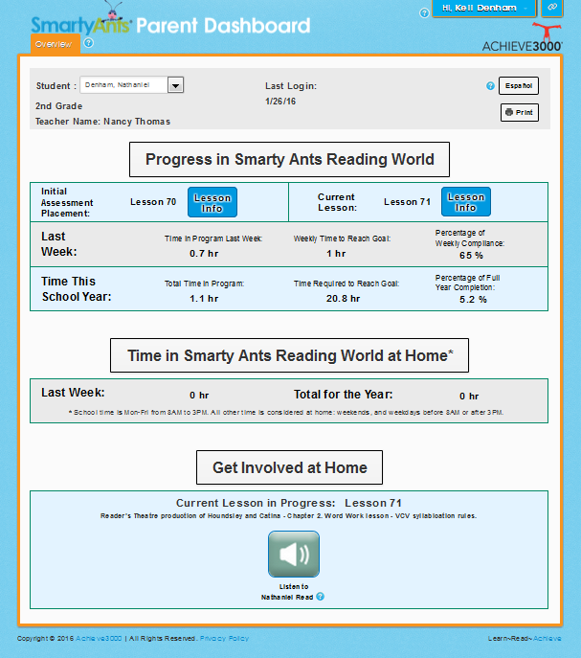
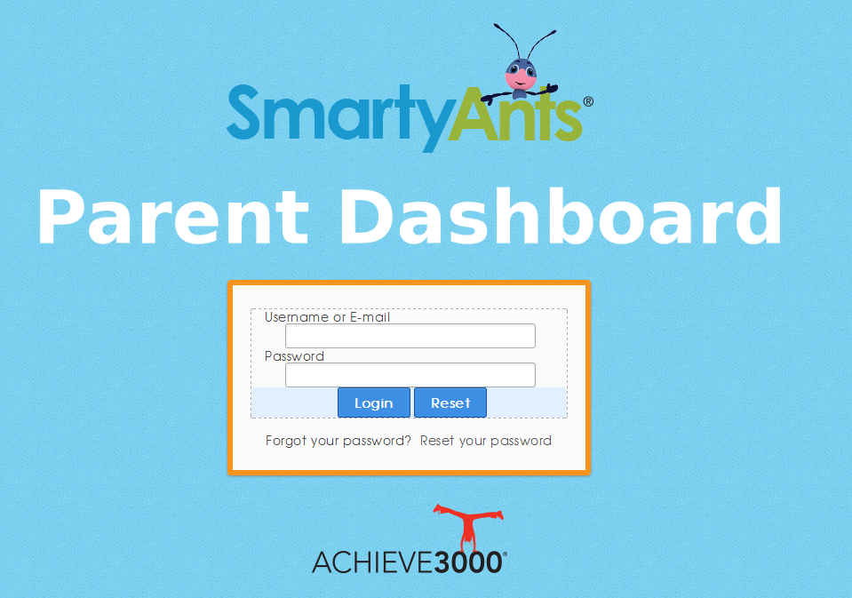
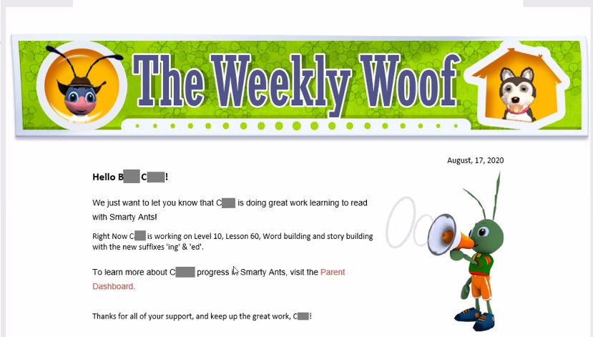
Parent Dashboard
Personalized Practice
Game-Based Engagement
Mastery of Foundational Skills

Slide 8

Partners in Success
Personalized Practice
Game-Based Engagement
Mastery of Foundational Skills

